Slide 1

Smart library
Subask.K 714020104092
Vigneshwar.N 714020104101
Suneeti.P.N. 714020104095
Pramoth V 714020104062

Slide 2

Agenda
Introduction
System Analysis
System Design
Implementation
Conclusion & Future scope

Slide 3

INTRODUCTION
Online Library Management Application is a system which maintains the information about the books present in the library, the students of college to whom books are issued, library staff and all. This is very difficult to organize manually. Maintenance of all this information manually is a very complex task. Owing to the advancement of technology, organization of an Online Library becomes much simple.

Slide 4
Aim and objectives
The project aims and objectives that will be achieved after completion of this project are discussed here. The aims and objectives are as follows:
Easier management of the book issue and return.
Easy tracking of Book status
Efficient management of student records

Slide 5
Requisites
DATABASE | KODULAR
Processor | Snapdragon or Mediatek Processor
OPERATING SYSTEM | Android
MEMORY | BASIC RAM SIZE
HARD DISK SPACE | 200 MB FOR FUTUTR USAGE

Slide 6
NEED OF SMART LIBRARY
The problem occurred before having computerized system includes:
File lost
When computerized system is not implemented file is always lost because of human environment.Some times due to some human error there may be a loss of records.
File damaged
When a computerized system is not there file is always lost due to some accdent like spilling of water by some member on file accidentally. Besides some natural disaster like floods or fires may also damage the files.

Slide 7
NEED OF SMART LIBRARY
Space consuming
After the number of records become large the space for physical storage of file and records also increases if no computerized system is implemented.
Cost consuming
As there is no computerized system the to add each record paper will be needed which will increase the cost for the management of library.

Slide 8
NEED OF SMART LIBRARY
Difficult to search record
When there is no computerized system there is always a difficulty in searching of records if the records are large in number.

Slide 9
EXISTING SYSTEM
Early days Libraries are managed manually. It required lot of time to record or to retrieve the details. The employees who have to record the details must perform their job very carefully. Even a small mistake would create a lot of problems. Security of information is very less. Report generations of all the information is very tough task.
Maintenance of Library catalogue and arrangement of the books to the catalogue is very complex task. In addition to its maintenance of member details, issue dates and return dates etc. manually is a complex task.

Slide 10
EXISTING SYSTEM
All the operations must be performed in perfect manner for the maintenance of the library with out any degradation which may finally result in the failure of the entire system.

Slide 11
PROPOSED SYSTEM
To solve the inconveniences as mentioned in the existing system, an Online Library is proposed. The proposed system contains the following features:
The students will register them through Online
Individually each member will have his account through which he can access the information he needs.
Book details like authors, number of copies totally maintained by library, present available number of books, reference books, non-reference books etc. all this information can be made handy.

Slide 12
PROPOSED SYSTEM
Regarding the members designation, number of books was issued.
Issue dates and returns of each member is maintained separately and fine charged if there is any delay in returning the book.
Time consuming is low, gives accurate results, reliability can be improved with the help of security.

Slide 13
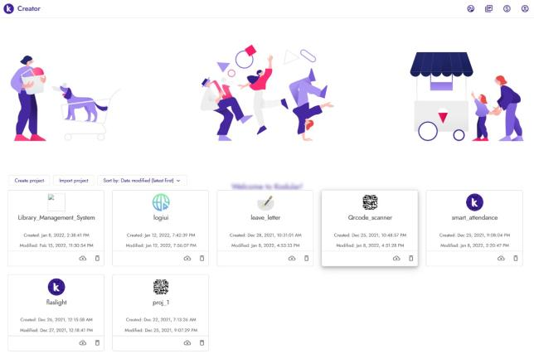
SYSTEM DESIGN

Slide 14
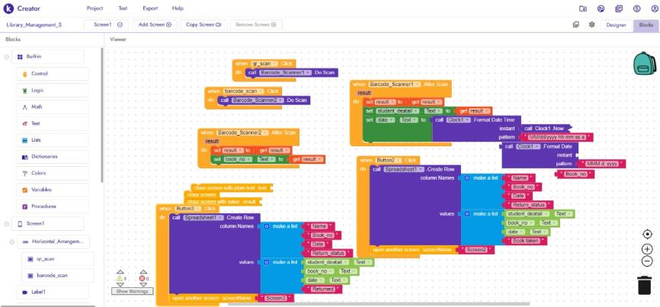
SYSTEM DESIGN

Slide 15
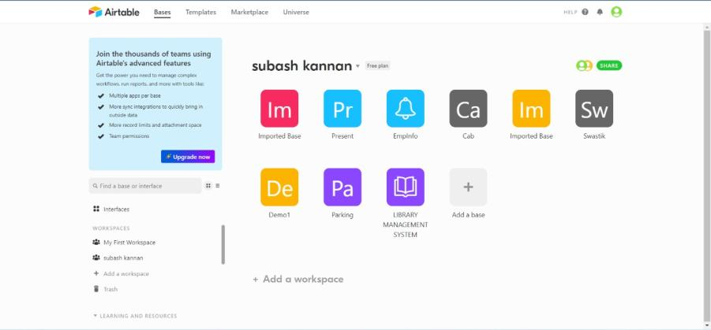
SYSTEM DESIGN

Slide 16
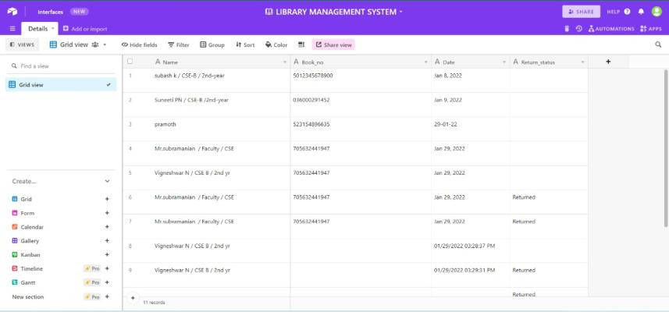
SYSTEM DESIGN

Slide 17
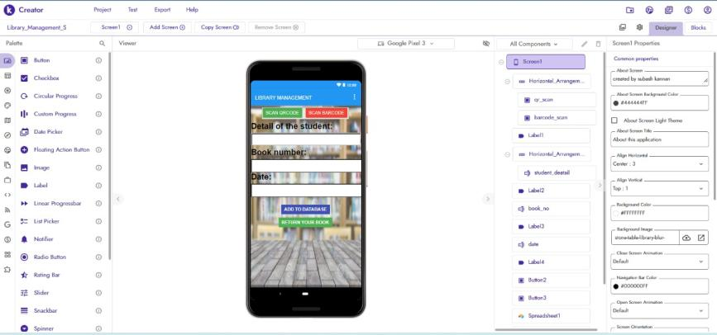
SYSTEM DESIGN

Slide 18
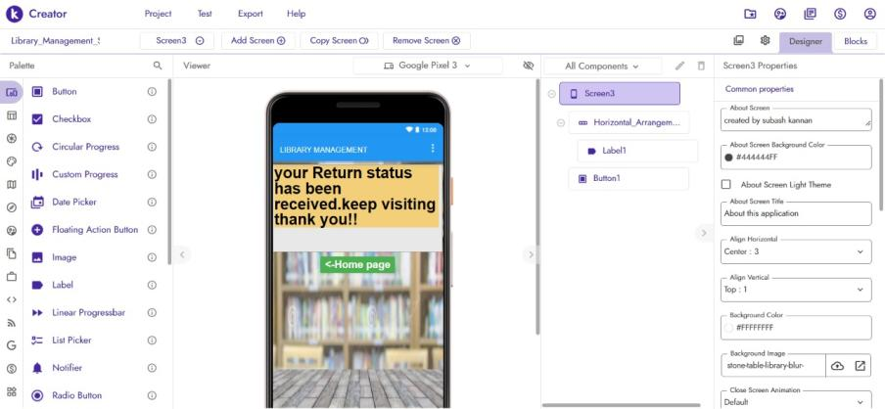
SYSTEM DESIGN

Slide 19
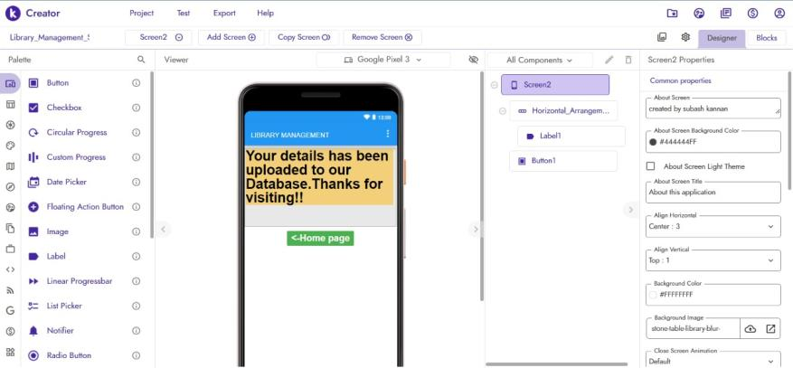
SYSTEM DESIGN

Slide 20
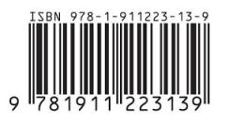


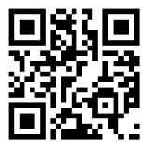

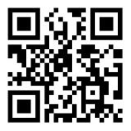
SYSTEM DESIGN

Slide 21



Application screenshots

Slide 22


Application screenshots

Slide 23

THANK YOU
Subask.K 714020104092
Vigneshwar.N 714020104101
Suneeti.P.N. 714020104095
Pramoth V 714020104062

